Slide 1

Gender Productivity Gap Among Star Performers in STEM and Other Scientific Fields
Herman Aguinis, Young Hun Ji, & Harry Joo (2018)
Journal of Applied Psychology
Vol. 103, No. 12, 1283-1306
Presentation by Young Hun Ji
18.01.2019

Slide 2
Gender Representation Gap in STEM Fields
In early education, boys and girls display similar participation in mathematics and science (e.g., Xie & Shauman, 2003).
Nonetheless, women are increasingly underrepresented in higher-level STEM professions, e.g., level of associate and full professor (Wolfinger, Mason, & Goulden, 2008):
In chemistry, women earned about 50% of bachelor degrees and 35% of Ph.D. degrees in 2008, but represented only 17% of faculty members at US research universities in 2011.
A survey of the Association of American Universities showed that women chaired only 2.7% of engineering departments, 5.9% of math or physical science departments, and 12.7% of life science departments (Niemeier & Gonzalez, 2004).
The persistent underrepresentation of women in STEM fields has tremendous societal, educational, and economic consequences.
Primary Research Question:
“Is there a gender productivity gap specifically among star performers in these fields?”
Notes:
-Talk stats: Financial impacts of stem vs non-stem careers etc. 25% greater earnings
-Gender gaps increase as move to higher education and professional STEM domains
-We know there is a gender representation gap overall, but what happens when we look specifically at star performers, those who are at the very far-right of the productivity distribution?

Slide 3
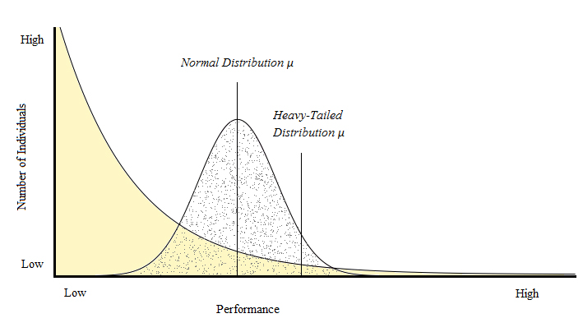
Star Performers in the 21st Century
Star performers are individuals who produce output and results many times greater than the rest of the individuals holding the same job or position (O’Boyle & Aguinis, 2012).
These individuals are characterized by disproportionately high and prolonged performance, visibility, and relevant social capital (Call, Nyberg, & Thatcher, 2015).
A recent set of studies demonstrated that star performers are more highly prevalent they would be under the assumption of normally distributed performance (Aguinis & O’Boyle, 2014).
Why examine stars?
Stars performers are highly influential and often serve as role models and mentors in their fields.
A gender performance gap among star performers in favor of men is more detrimental to the success of all women performers than an equivalent gap among average performers.
Notes:
Definition of stars. Stars produce outputs several times greater than the rest of the individuals holding the same job. They are highly influential and are sought after by organizations.
Every once in a while, you’ll come across business scholars who have CVs that are 100 pages long….with 200 publications…they are star performers….
2. Traditionally, it’s been the case that a lot of organizational policies and practices assume a normal distribution of individual productivity. However, a set of recent studies show that most people actually perform below the mean, and the distribution of individual productivity has a very heavy right tail, where a lion share of total output is produced by a small proportion of elite performers. Individual productivity data of researchers, politicians, athletes, celebrities, all tend to demonstrate this phenomenon of heavy-tailed distribution of individual productivity.
3. So, the productivity differential between stars and non-stars is much greater than we would assume under normally distributed performance. And, ultimately, the importance of stars, and their impact when it comes to total organizational outputs is much greater than we used to think.
4. So then, going back to the focus of our study, why is it important to examine the gender gap specifically among star performers?
Well, not only are star performers the most prolific producers, far more than we originally thought, stars are highly influential and serve as important role models.
For example, women are more inspired by outstanding female mentors than by equivalently outstanding male mentors. There is also evidence of gender homophily, in general, when it comes to mentor-protégé relationships. So, both mentors and proteges have the tendency to seek those within their own gender group.
Ultimately, whether through their presence or their absence, stars performers generate impacts and trickle-down effects that ripple throughout entire organizations and occupational domains.
And, when you have a gender-star gap in favor of men, in many ways, that is more detrimental to all women than an equivalent gap among average performers.

Slide 4
Research Questions & Overview
Research Questions:
Is there a gender productivity gap among star performers in STEM and other scientific fields? If so, what causes it?
Are there differences across scientific domains (e.g., mathematics versus genetics)?
Research Overview:
4 Samples: S1: Mathematics, S2: Genetics, S3: Applied Psychology & Mathematical Psychology
Productivity data: Number of papers published in top journals by individual researchers by gender and across scientific domains
Theory testing & development: (1) Observe the shape of individual productivity distributions → (2) Identify the dominant generative mechanism for star performance → (3) Infer the most logical gender-based explanation for any gender productivity gaps among stars → (4) Generate recommendations for minimizing gender-star gaps
Notes:
Research questions
Our samples, and our data
So now I’ll explain briefly the sequence of steps we used to examine the gender-star gap and its predominant cause. First, using our data, we observe the shape of the individual productivity distributions, and we do this for each gender group and for each scientific domain. The shape of the distributions will reveal the predominant process by which star performance occurs. As I’ll explain later, there are a set of theoretical distributional shapes, each of which is associated with a predominant generative mechanism that is causing that shape to occur. For example, the dominant mechanism for a normal distribution is that of homogenization, where total outputs tend to converge towards the mean. So, by observing the shape of the productivity distributions, we can identify the predominant mechanism that explains how individuals are differentiating themselves in terms of productivity, and how a small portion of stars are able to outperform the rest to the extent that they do.
Next, by identifying the dominant mechanism for an observed distribution, we can also infer the most likely gender-based explanation for any gender-star gaps observed. As I will explain in the following slides, there are several competing gender-based explanations with regard to the overall gender gap in STEM fields. By identifying the predominant mechanisms that drive star performance, we can also infer which of the competing gender perspectives can best explain why those mechanisms work differently for men versus women.
And finally, by understanding both the predominant mechanism that shape star performance and the likely gender based explanations for the gender-star gap, we can generate recommendations for interventions aimed at minimizing such gaps.

Slide 5
Study Contributions
We show that the gender gap among stars in these fields is more severe than the total gender gap among all performers.
We identify the predominant mechanism that enables star performance across STEM fields and genders.
We infer the most-likely gender-based explanation for the gender productivity gap specifically among stars, based on the predominant mechanism identified.
We provide novel practical suggestions for minimizing the gender-star gap in STEM fields.
Notes:
We show that there is an even bigger gender gap among stars than among all performers. This result speaks to the urgency of the issue of gender inequality in STEM fields. This finding shows that the solution isn’t simply about raising female participation in these fields, and additional, more complex efforts are required to address the gender-star issue.
Next, we identify the predominant mechanism that explains how individuals differentiate their productivity, across STEM fields and across gender groups. So, we are generating knowledge about how star performance occurs across genders and occupational domains. This is a significant contribution to the research on star performers as well as of women in STEM fields.
And, we further bridge the two research streams by generating theory on the predominant cause of the gender productivity gap specifically among stars.
Finally, we provide practical suggestions for minimizing the gender productivity gap in STEM and other scientific fields, specifically among star performers.

Slide 6
3 Competing Explanations for the Gender Gap
1. Biological factors that lead to gender differences across cognitive domains (e.g., Stoet & Geary, 2012)
Sex differences in brain lateralization patterns
Innate & fixed
2. Gender differences in career and lifestyle choices: Women ‘opt out’ of STEM fields
Gender differences in family and occupational values (Ceci, Ginther, Kahn, & Williams, 2014)
Psychological & volitional
3. Gender discrimination: Women are ‘pushed out’ of STEM fields
Gender biases in hiring, promotions, grant funding, journal reviewing (Chesler et al., 2010)
‘Matilda effect’ among colleagues, supervisors, and reviewers, etc.
External & socio-cultural

Slide 7
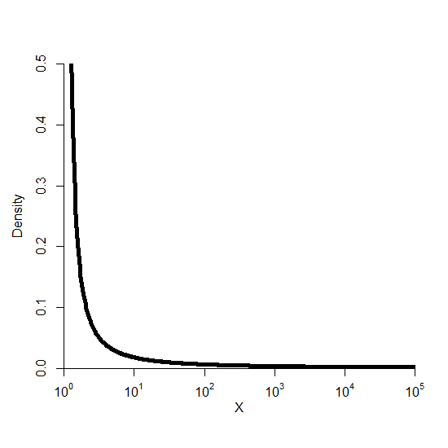
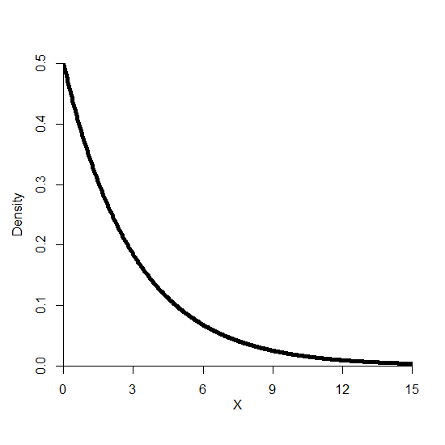
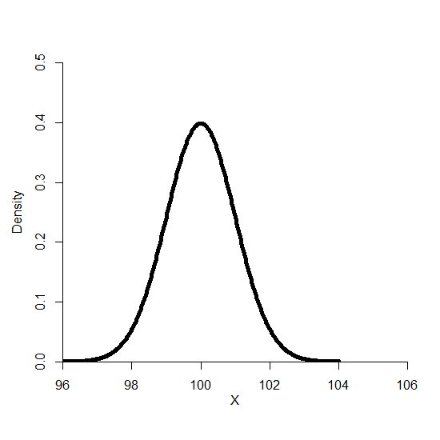
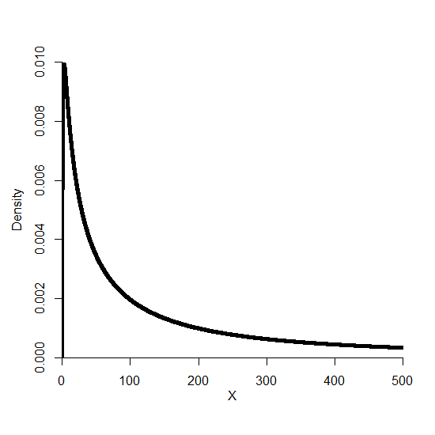
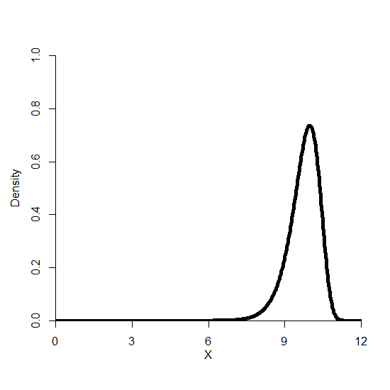
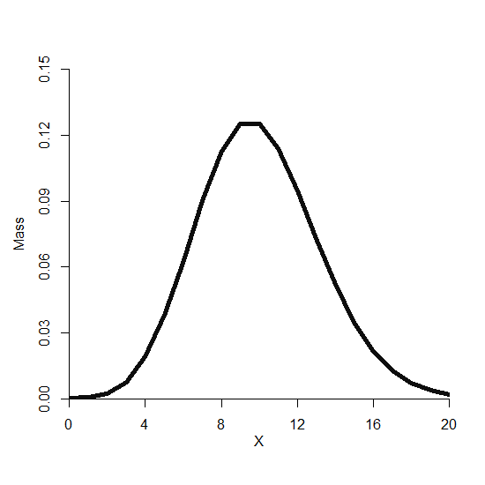
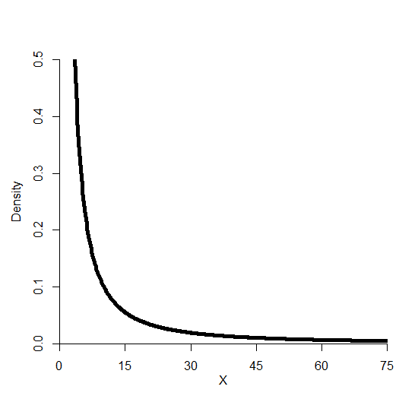
7 Theoretical Distributions & 4 Dominant Generative Mechanisms
Joo, Aguinis and Bradley (2017) provide a taxonomy of individual output distributions and their associated generative mechanisms.
1. Pure power law
3. Exponential
5. Normal
2. Lognormal
4. Power law with exponential cutoff
6. Weibull
7. Poisson
Notes:
These distributions…they are found everywhere in the world around us. But one thing to note is that each of these distributions have unique mathematical properties, and those properties are universal across contexts. For example, you might observe an exponential distribution in the growth of a particular species of mushrooms in a forest, the distribution of wages in the labor market, or in the total number of albums released by individual musicians over the course of their careers—I just made that up—uh…It doesn’t matter where you find it. They can be from different contexts, but a particular theoretical distribution will always follow its associated mathematical properties and , likewise, that particular shape you observed is always created predominantly by the same generative mechanism.

Slide 8
Pure Power Law & Self-Organized Criticality
Pure power law
Technical description:
A set of values from a variable, or 𝑥, follows a pure power law if:
Where alpha (α) (> 1) is the rate of decay. The lower the value of α, the heavier the distribution’s right tail
Out of the seven distributions, the pure power law has the heaviest right hand tail (seemingly infinite).

Slide 9
Pure Power Law & Self-Organized Criticality
Pure power law
Generative mechanism: Self organized criticality, a process where some individuals reach ‘critical states’ triggered by an interaction of events that lead to large ‘output shocks’ (Joo et al., 2017). Increases in output after reaching critical states are unpredictable and potentially extremely large.
Examples:
A researcher may discover a unique set of findings by chance, which subsequently helps the scientist rapidly discover a much larger set of findings.
Research in physics has found that the distribution of the magnitude of sand avalanches follows a power law distribution (Bak, 1996).

Slide 10
Pure Power Law & Self-Organized Criticality
Pure power law
Generative mechanism: Self organized criticality, a process where some individuals reach ‘critical states’ triggered by an interaction of events that lead to large ‘output shocks’ (Joo et al., 2017). Increases in output after reaching critical states are unpredictable and potentially extremely large.
H1a: Individual productivity of women and men in STEM and other scientific fields follows a pure power law distribution.
H1b: The pure power law distribution of individual productivity will have a lighter right tail for women than men.
A lighter right tail for women likely reflects the impacts of gender discrimination
and/or gender differences in career and lifestyle choices
Notes:
H1a: Paradigm shifting breakthroughs depend on the successful interaction of multiple components and events. So, researchers may reach critical states when certain performance components interconect,--e.g., a set of interrelated projects regarding potential cures for a single disease. So, star performance in scientific fields may be a reflection of large output shocks following such eureka moments.
H1b: A gender productivity gap under a power law distribution means that self-organized criticality is working differently for men versus women. The mechanism is relatively constrained for one gender. We theorized that this would occur due to either discrimination (hiring, promotion, grant funding, mentorship, matilda effect) or gender differences in life choices (decision to have children early in ones career, making various career sacrifices). Innate ability, on the other hand, is fixed over time, it’s a constant. gender differences in innate ability shouldn’t affect the strength of the self-organized criticality mechanism. Even if there are some performance differences between men and women due to differences in ability, the overall shape of the distribution, and in particular, the heaviness of the right tail, shouldn’t differ substantially due to ability differences.

Slide 11
Lognormal Distribution & Proportionate Differentiation
Lognormal
Technical description:
A set of values from a variable, or 𝑥, follows a lognormal distribution if:
Where μ is the mean and σ (>0) is the standard deviation. The higher the standard deviation, the heavier the right tail of the distribution.
Out of the seven distributions, the lognormal distribution has the second heaviest (but ultimately finite) right hand tail.

Slide 12
Lognormal Distribution & Proportionate Differentiation
Generative mechanism: Proportionate differentiation. Individual differences in value on an outcome occur due to differences with respect to the accumulation rate and initial value on the outcome (Joo et al., 2017).
As such, some individuals experience large ‘output loops’ (i.e., increasingly larger output increases based on positive feedback between past and future output).
Lognormal
Examples:
Community organizers with a higher number of initial signatures may find it easier to obtain additional signatures.
Research in geology shows that a crystal’s initial size and its rate of exposure to additional minerals determine its subsequent sizes, creating a lognormal distribution of crystal sizes (Kile & Eberl, 2003).

Slide 13
Lognormal Distribution & Proportionate Differentiation
Generative mechanism: Proportionate differentiation. Individual differences in value on an outcome occur due to differences with respect to the accumulation rate and initial value on the outcome (Joo et al., 2017).
As such, some individuals experience large ‘output loops’ (i.e., increasingly larger output increases based on positive feedback between past and future output).
Lognormal
H2a: Individual productivity of women and men in STEM and other scientific fields follows a lognormal distribution.
H2b: The lognormal distribution of individual productivity will have a lighter right tail for women than men.
A lighter right tail for women likely reflects the impacts of gender discrimination.
Notes:
H2a: Greater past outputs means greater scholarly reputation, and this means greater investment of resources from others, thus creating a feedback loop between past outputs, and whatever input components one accumulates in the present. Even for children, the kids who display early successes are often placed into advanced placement programs from math and science, receive private tutoring, greater attention from teachers, and so, that reinforces productivity.
H2b: A gender productivity gap in a lognormal distribution means that proportionate differentiation is working differently for men versus women. The mechanism is stronger for men.
We argue that, a gender productivity gap under a lognormal distribution, in favor of men, is most likely a reflection of gender discrimination.
Matilda effect (Sarsons (2015) found that women incur a penalty for co-authored publications that men do not experience). People tend to overestimate and overvalue the achievements of men compared to women, even if they are in reality, comparable. This even stars in early childhood, where parents and teachers are more likely to view their sons and male students as more scientifically predisposed, and will use more numbers in their speech. There have been experiments where, are more likely to hire a candidate with a male first name for a science role compared to a candidate with an identical CV but with a female first name.
On the other hand ability and lifestyle choices are intrapersonal. Proportionate differentiation is about external and interpersonal processes that create a feedback loop between past outputs and current activities onto future outputs. It’s the actions of other people, and socio-cultural and system-level factors that determines the strength of proportionate differentiation. Even if, say, gender differences in ability or life choices lead to greater performance for men at one point in time and so maybe the mean performance is greater for men, but all else considered equal, the strength of the feedback mechanism will still stay the same. The shape of the overall distribution, and, in particular, the heaviness of the right tail should be more or less equivalent.

Slide 14
Exponential-tail Distributions & Incremental Differentiation
Exponential
Technical descriptions:
A set of values from a variable, or 𝑥, follows an exponential distribution if:
Where λ (>0) is the rate of decay. The lower the value of λ, the heavier the distribution’s right tail.
A set of values from a variable, or 𝑥, follows a power law with exponential cutoff if:
Where α (>1) and λ (>0) are the rates of decay. The lower the values of α and λ, the heavier the distribution’s right tail. Between the two rates of decay, λ is stronger in shaping the distribution’s right hand tail.
Power law with exponential cutoff

Slide 15
Exponential-tail Distributions & Incremental Differentiation
Exponential
Generative mechanism: Incremental differentiation. Individual differences in total output differ due to differences with respect to output accumulation rates, i.e., output generated per opportunity to perform (Joo et al., 2017).
Due to differences in accumulation rates, some individuals enjoy larger ‘output increments,’ i.e., larger linear increases in output.
Examples:
Differences across individuals in terms of labor productivity lead them to accumulate wages at different linear rates (Nirei & Souma, 2007).
The accumulation of links with other nodes (e.g., between airports) follows a power law with exponential cutoff (Amaral et al., 2000).
Power law with exponential cutoff

Slide 16
Exponential-tail Distributions & Incremental Differentiation
Exponential
Generative mechanism: Incremental differentiation. Individual differences in total output differ due to differences with respect to output accumulation rates, i.e., output generated per opportunity to perform (Joo et al., 2017).
Due to differences in accumulation rates, some individuals enjoy larger ‘output increments,’ i.e., larger linear increases in output.
Power law with exponential cutoff
H3a: Individual productivity of women and men in STEM and other scientific fields follows an exponential tail distribution.
H3b: The exponential tail distribution of individual productivity will have a lighter right tail for women than men.
A lighter right tail for women likely reflects the impacts of gender discrimination.

Slide 17
(Potentially) Symmetric Distributions & Homogenization
Normal
Technical descriptions:
Normal distribution:
The lower the value of σ, the lighter the distribution’s symmetric tails.
Weibull distribution:
The lower the value of β (>0), the heavier the distribution’s left tail.
Poisson distribution:
The lower the value of μ (>0), the heavier the distribution’s right tail.
Weibull
Poisson

Slide 18
(Potentially) Symmetric Distributions & Homogenization
Normal
Generative mechanism: Homogenization, a process where individuals undergo output homogenization leading to lower variability in individual output over time (Joo et al., 2017).
Examples:
Uniform expectations of production and service reduce the variability of output among assembly line workers and service workers.
Research in entomology found that mouth-to-mouth feeding, social grooming, and other physical contact among ants homogenized their scent (Lenoir et al., 2001).
Weibull
Poisson

Slide 19
(Potentially) Symmetric Distributions & Homogenization
Normal
Generative mechanism: Homogenization, a process where individuals undergo output homogenization leading to lower variability in individual output over time (Joo et al., 2017).
H4a: Individual productivity of women and men in STEM and other scientific fields follows a (potentially) symmetric distribution.
H4b: The (potentially) symmetric distribution of individual productivity will have a lighter right tail for women than men.
Weibull
Poisson
A lighter right tail for women likely reflects the impacts of
gender differences in career and lifestyle choices.
Notes:
I have longer lunches at Aalto now. Maybe that’s a good thing or a bad thing. But it impacts all of us and has a homogenizing effect.

Slide 20
Method—Samples
Study 1: All researchers who have published at least one article in the top ten most influential journals in the field of Mathematics (3,161 articles) from 2006 to 2015.
N = 3,853 unique authors of whom 360 (9%) were women.
Study 2: All researchers who have published at least one article in the top five most influential journals in the field of Genetics from (7,746 articles) 2006 to 2015.
N = 45,007 unique authors of whom 14,685 (32.6%) were women.
Study 3: All researchers who have published at least one article in the top five most influential journals in the field of Applied Psychology (2,807 articles) and of Mathematical Psychology (3,796 articles) from 2006 to 2015.
Applied Psychology: N = 4,081 unique authors of whom 1,595 (39.1%) were women.
Mathematical Psychology: N = 6,337 unique authors of whom 2,117 (34.4%) were women.

Slide 21
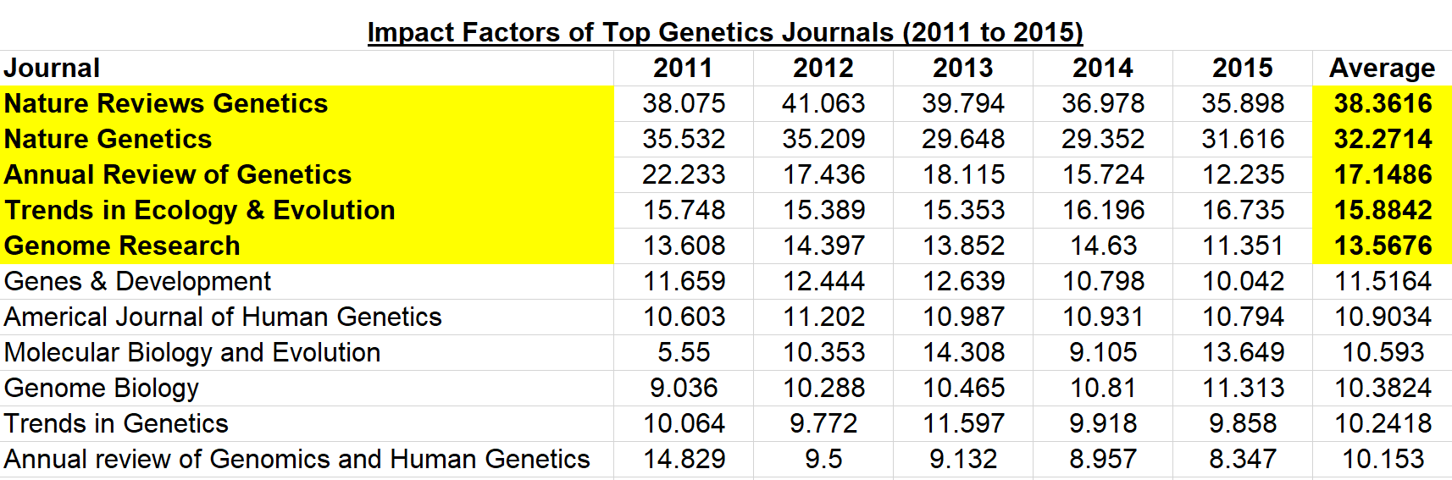
Method—Journal Selection Criteria
Identifying the most influential journals in each field:
Journals in each field (mathematics, genetics, applied psychology, and mathematical psychology) were ranked based on their average journal impact factor over the past five years.
Journal impact factor: the average number of citations received per publication in that journal in the two preceding years.

Slide 22
Method—Measures
Individual Research Productivity: An individual’s total count of the number of papers published in the top 5 journals in their field (top 10 for mathematics) from 2006 to 2015. All articles and associated metadata were collected using the Web of Science database.
Gender: We coded the gender of all individuals manually.
Identify the author’s gender via their first name.
If the first name is ‘gender-ambiguous,’ search for the author’s web page (personal, faculty, ResearchGate, Google Scholar, etc.) for a photo or other information that would reveal the author’s gender.
If first name is ambiguous AND there is no web page for the author, use the Namepedia.org database to record the most likely gender given the author’s first name and geographical/ethnic information.

Slide 23
Method—Data Analytic Approach
1. Distribution Pitting: A falsification-based approach that pits each of the theoretical distributions against one another in terms of their fit with the observed distribution.
The R package Dpit performs pairwise comparisons of distribution fit between the seven theoretical distributions.
3 decision rules: (1) Log-likelihood ratio (LR) values, (2) Principle of parsimony, and (3) Principle of triangulation. The ‘last one standing’ is deemed the theoretical distribution with the best fit with the observed data.
2. Fit Parameters and Descriptive Statistics: Fit parameters describe the heaviness of the distribution’s right tail. Differences in the size of the fit parameters for men versus women reflect the size of the gender-star gap.
3. Bootstrapping and Permutation: Bootstrapping: 5,000 replications (50,000 for Study 2) of each best-fitting distribution’s parameter value to compute its 95% confidence interval. Permutation: Significance test of the difference between actual versus expected number/proportion of women among top producers based on 20,000 simulations.
Notes:
3. These are resampling (with replacement) techniques. Bootstrapping: Lots of samples are taken from the original sample, and, for each, the fit parameter is estimated. We now get a distribution that describes the 95% confidence interval for the parameter.
Permutation: Similarly, 20,000 simulations are used to create distribution of expected number of women in the top 1, 5, and 10% of producers. Then, we can estimate the p-value for the actual number of women we observed in the sample.

Slide 24
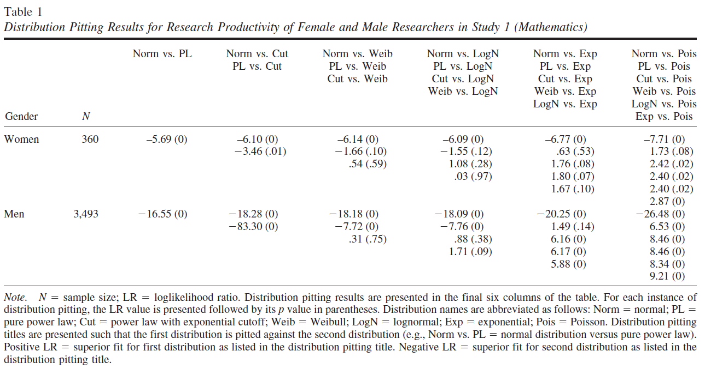
Distribution Pitting Results
In all groups, the power law with exponential cutoff distribution had the best fit with the observed data.
Individuals differentiate their research productivity predominantly via incremental differentiation.

Slide 25
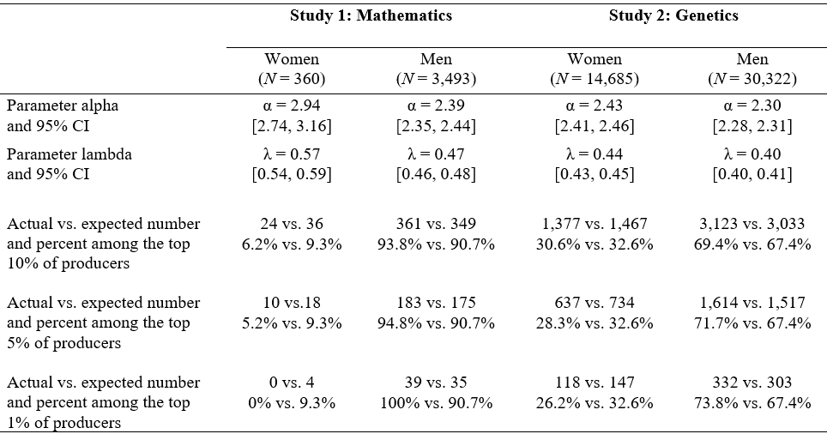
Fit Parameters, Bootstrapping, and Permutation Results for Studies 1 and 2

Slide 26
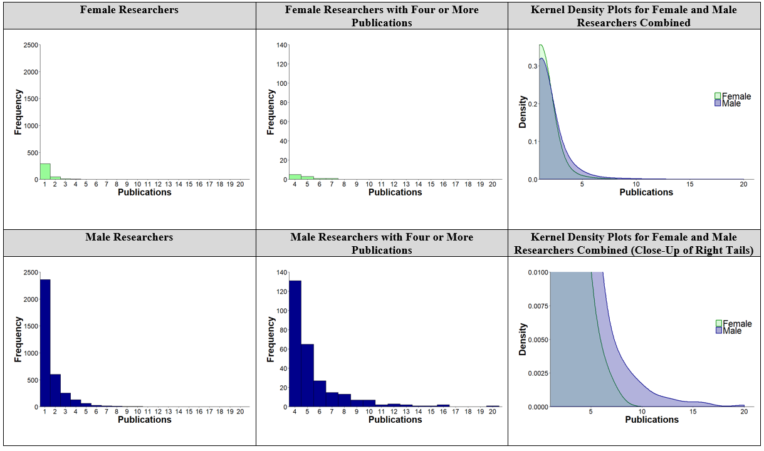
Histograms and Kernel Density Plots for Study 1 (Mathematics)

Slide 27
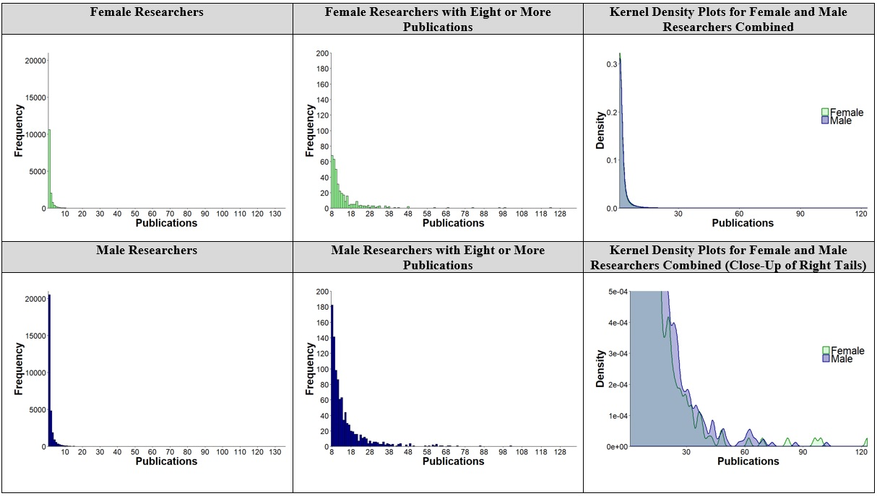
Histograms and Kernel Density Plots for Study 2 (Genetics)

Slide 28
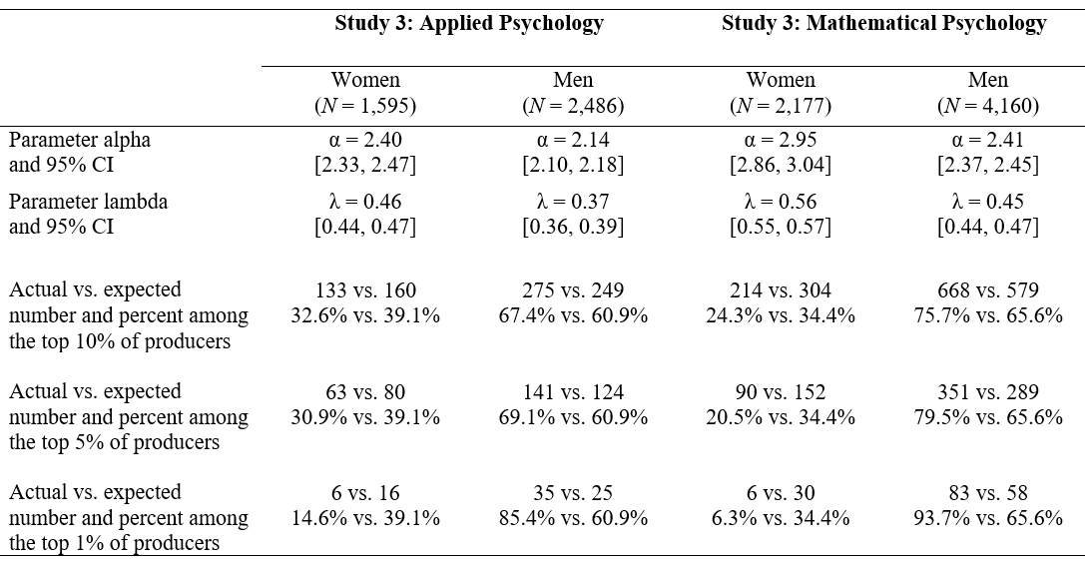
Fit Parameters, Bootstrapping, and Permutation Results for Study 3

Slide 29
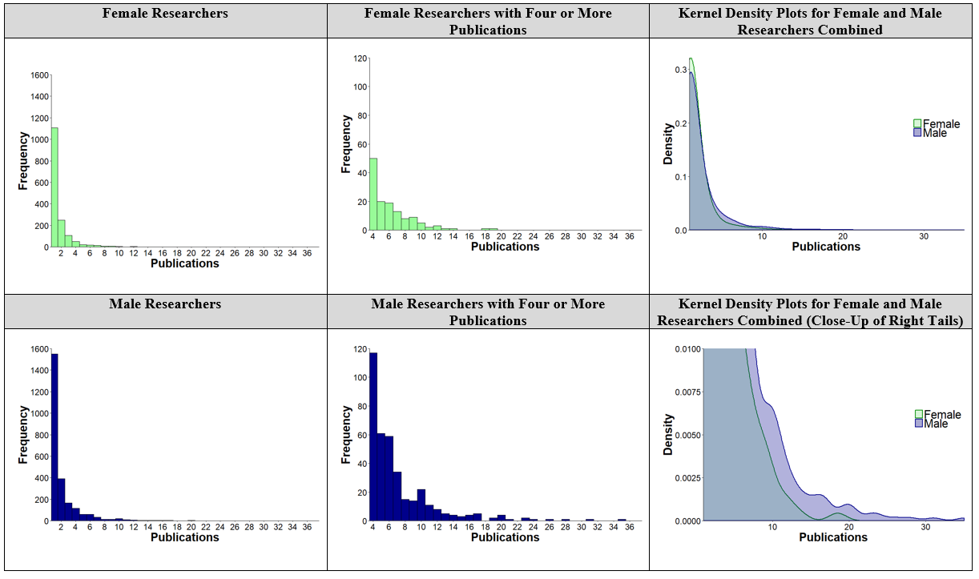
Histograms and Kernel Density Plots for Study 3 (Applied Psychology)

Slide 30
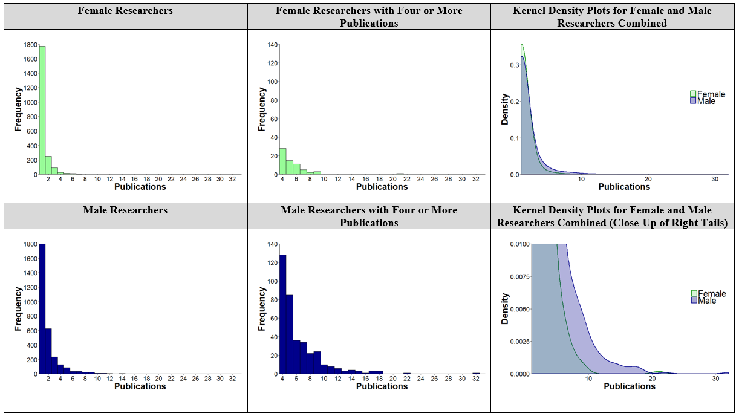
Histograms and Kernel Density Plots for Study 3 (Mathematical Psychology)

Slide 31
Implications for Theory
Individuals differentiate their research productivity predominantly via incremental differentiation.
The consistency of the dominance of incremental differentiation across genders and academic domains
Gender discrimination is the most likely cause for the observed gender-star gaps.
Gender productivity gaps among stars may be prevalent in fields that do not have the reputation of being traditionally masculine (e.g., applied psychology).
Gender-star gaps may explain a chain of consequences that could ripple throughout entire domains.

Slide 32
Implications for Practice
A difference of 1 or 2 papers in top journals can be huge for individual researchers’ careers.
Women need to accumulate input components at a greater rate than men in order to achieve the same level of increase in total outputs.
Simply encouraging greater female participation in science is not enough. Organizations need to do more to address the gender gap specifically among stars.
What can organizations do to ‘de-constrain’ incremental differentiation among women?
Cluster hiring
Greater emphasis on fairness and transparency regarding policies
Greater utilization of stars as a source of mentoring and coaching
Policies aimed at increasing female star retention (e.g., idiosyncratic work arrangements)

Slide 33
Limitations & Future Directions
Incremental differentiation was revealed to be the most dominant mechanism, not the sole mechanism at play.
We did not directly examine ability, gender discrimination, and gender differences in career & lifestyle choices.
Future studies could:
Examine research productivity growth longitudinally
Explore the effects of researchers’ collaborative network ties
Identify the forms of gender discrimination most pertinent to female stars
Notes:
For all we know, ALL of mechanisms could have been very strong, just with incremental being the strongest.
2. Same with ability, discrimination, and life choices.
3. Maybe there is a certain point in time where productivity diverges. Networks is something that could be interesting--perhaps a strategy for women could be found here? We know about gender discrimination for all women, but a lot of these only impact whether women opt in or out, like hiring discrimination. What about for people who have opted in and are very competent. What are the forms of gender discrimination for women stars specifically?

Slide 34

Questions?

Slide 35
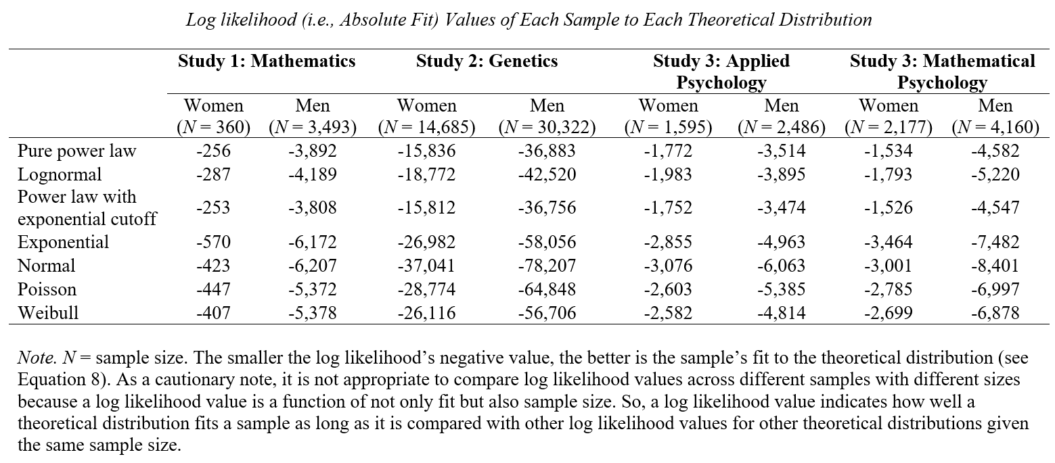
Appendix: LR values

